Slide 1
Limits an derivatives
Shreyas M
B.Tech in ECE PES University Bangalore

Slide 2
Chapter map
Section | Topics
1 | Introduction
2 | Basics
3 | Limits
4 | Cases of limits
5 | Sandwich or squeeze theorem
6 | Standard limits
7 | First derivative principle
8 | Derivatives
9 | L’ Hospital’s rule (LH rule)

Slide 3
1 Introduction
The concept of Limits and Derivatives was first originated and put forth by Leibnitz. This is the first step of understanding into the branch of mathematics called ‘Calculus’ which is the branch dealing with study of change and RATE of change of mathematically representable quantities
For example, velocity is said to be the first order derivative of position (rate of change of position over time). The second order derivative of the position is the acceleration (rate of change of velocity over time. Impulse is the third order derivative of position (rate of change of acceleration over time) and so on.

Slide 4
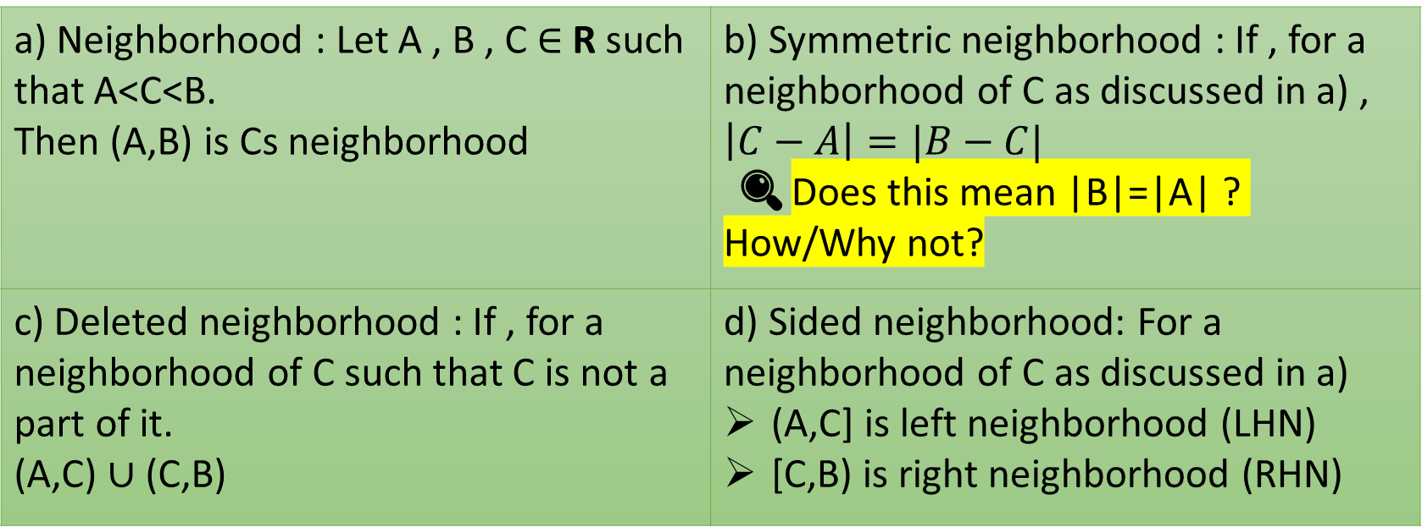
2 Basics
Understanding of few basic terms related to domain of a function
There are various types of neighborhoods
a) Neighborhood : Let A , B , C $∈$ R such that A<C<B. Then (A,B) is Cs neighborhood | b) Symmetric neighborhood : If , for a neighborhood of C as discussed in a) , $$\left|C−A\right|=|B−C|$$ 🔍Does this mean |B|=|A| ? How/Why not?
c) Deleted neighborhood : If , for a neighborhood of C such that C is not a part of it. (A,C) $∪$ (C,B) | d) Sided neighborhood: For a neighborhood of C as discussed in a) (A,C] is left neighborhood (LHN) [C,B) is right neighborhood (RHN)

Slide 5
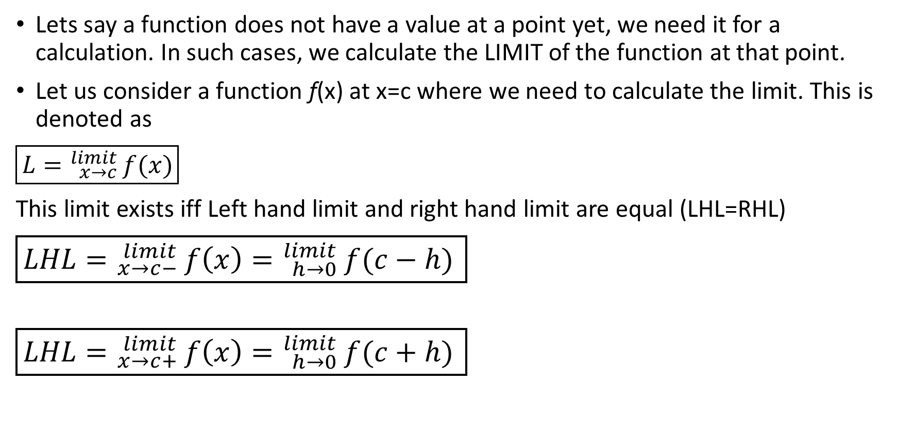
3 Limits
Lets say a function does not have a value at a point yet, we need it for a calculation. In such cases, we calculate the LIMIT of the function at that point.
Let us consider a function f(x) at x=c where we need to calculate the limit. This is denoted as
$\boxed{L={}_{x→c}^{limit}{ f(x)}}$
This limit exists iff Left hand limit and right hand limit are equal (LHL=RHL)
$\boxed{LHL={}_{x→c−}^{limit}{ f\left(x\right)={}_{h→0}^{limit}{ f(c−h)}} }$
$$\boxed{LHL={}_{x→c+}^{limit}{ f\left(x\right)={}_{h→0}^{limit}{ f(c+h)}} }$$

Slide 6
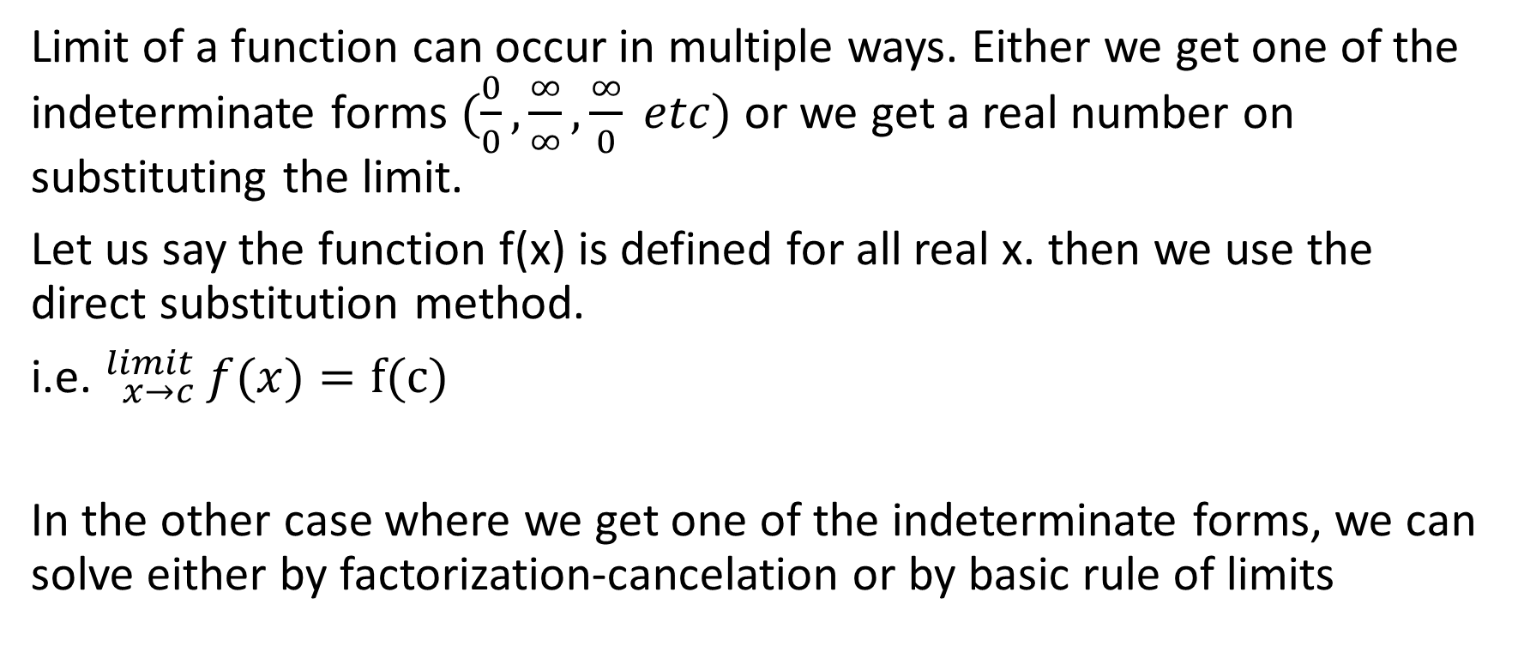
4 Cases of limits
Limit of a function can occur in multiple ways. Either we get one of the indeterminate forms $(\frac{0}{0},\frac{∞}{∞},\frac{∞}{0} etc)$ or we get a real number on substituting the limit.
Let us say the function f(x) is defined for all real x. then we use the direct substitution method.
i.e. ${}_{x→c}^{limit}{ f(x)}=f(c)$
In the other case where we get one of the indeterminate forms, we can solve either by factorization-cancelation or by basic rule of limits

Slide 7
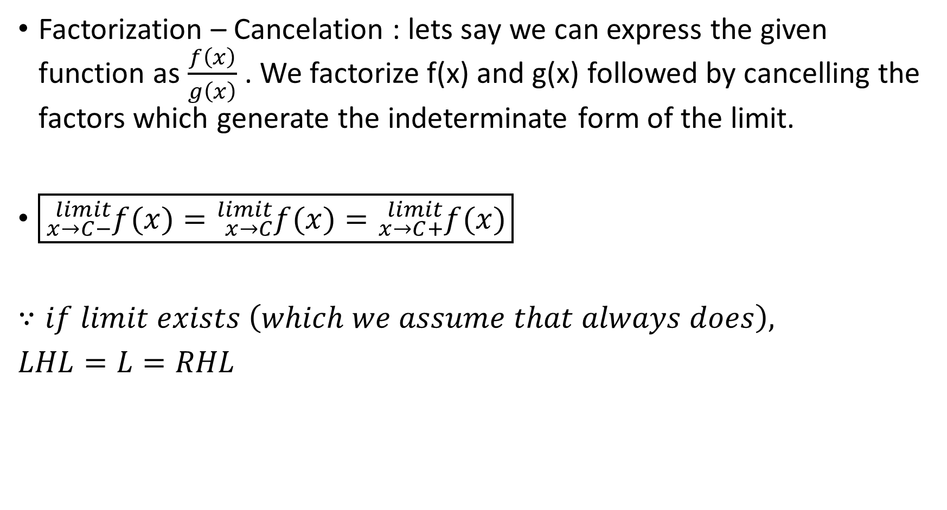
Factorization – Cancelation : lets say we can express the given function as $\frac{f\left(x\right)}{g\left(x\right)}$ . We factorize f(x) and g(x) followed by cancelling the factors which generate the indeterminate form of the limit.
$\boxed{{}_{x→C−}^{limit}{f(x)}={}_{x→C}^{limit}{f(x)}={}_{x→C+}^{limit}{f(x)}}$
$∵if limit exists \left(which we assume that always does\right),$
$LHL=L=RHL$

Slide 8
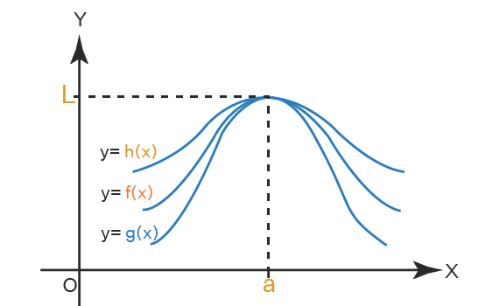

5 Sandwich/Squeeze theorem
Let us assume three functions g$\left(x\right)≤f\left(x\right)≤h(x)$ have the limits F,G,H respectively for x → a.
Sandwich theorem (Squeeze theorem) states that “If G=H=L, then F=L”

Slide 9
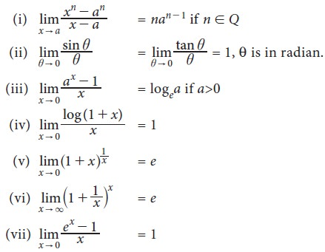
6 Some standard limits
Remembering the following pre-derived limits might come in handy while solving problems

Slide 10
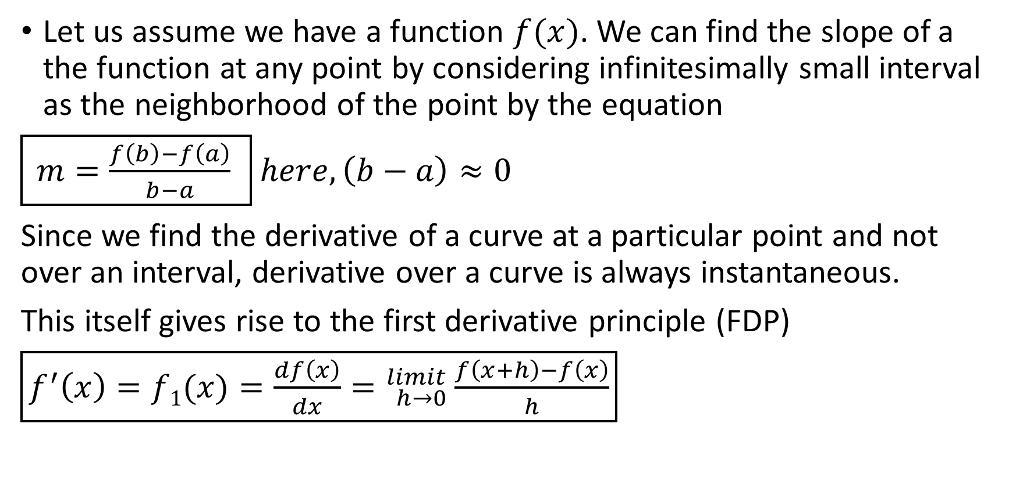
7 First derivative principle
Let us assume we have a function $f(x)$. We can find the slope of a the function at any point by considering infinitesimally small interval as the neighborhood of the point by the equation
$\boxed{ m=\frac{f\left(b\right)−f\left(a\right)}{b−a} } here, \left(b−a\right)≈0$
Since we find the derivative of a curve at a particular point and not over an interval, derivative over a curve is always instantaneous.
This itself gives rise to the first derivative principle (FDP)
$\boxed{f^{′}\left(x\right)=f1(x)=\frac{df\left(x\right)}{dx}={}_{h→0}^{limit}{ \frac{f\left(x+h\right)−f\left(x\right)}{h}}}$

Slide 11
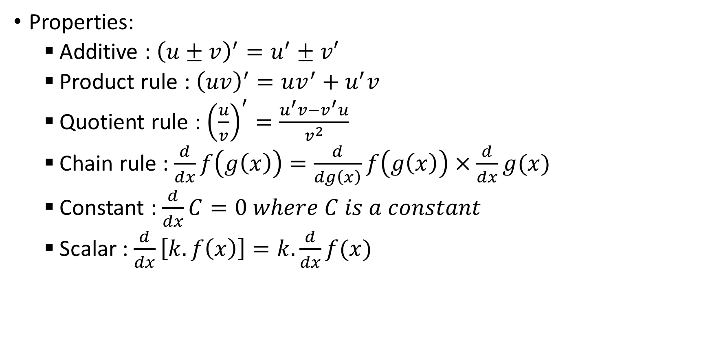
8 Derivatives
Properties:
Additive : ${\left(u±v\right)}^{′}=u^{′}±v′$
Product rule : ${\left(uv\right)}^{′}=uv^{′}+u^{′}v$
Quotient rule : ${\left(\frac{u}{v}\right)}^{′}=\frac{u^{′}v−v^{′}u}{v^{2}}$
Chain rule : $\frac{d}{dx}f\left(g\left(x\right)\right)=\frac{d}{dg\left(x\right)}f\left(g\left(x\right)\right)×\frac{d}{dx}g(x)$
Constant : $\frac{d}{dx}C=0 where C is a constant$
Scalar : $\frac{d}{dx}\left[k.f\left(x\right)\right]=k.\frac{d}{dx}f(x)$

Slide 12
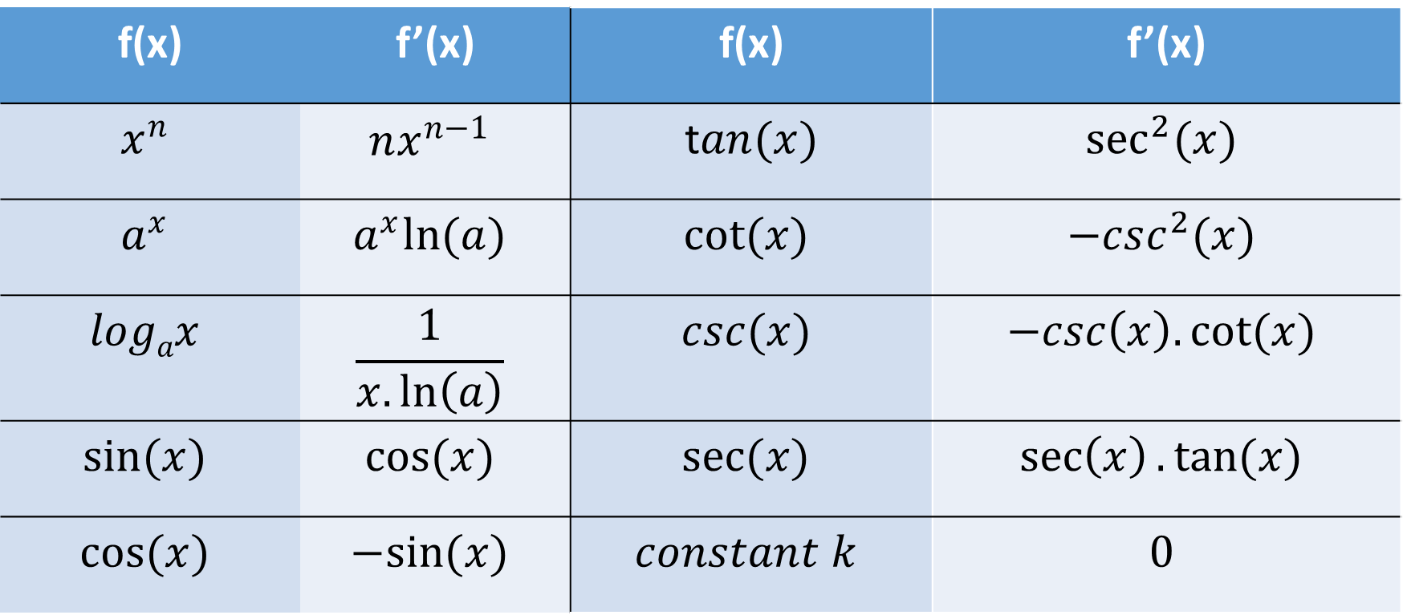
Derivative of some elementary functions are given below
f(x) | f’(x) | f(x) | f’(x)
$$x^{n}$$ | $$nx^{n−1}$$ | t$an(x)$ | $$\sec^{2}{(x)}$$
$$a^{x}$$ | $$a^{x}ln(a)$$ | $$cot(x)$$ | $$−csc^{2}(x)$$
$$logax$$ | $$\frac{1}{x.\ln\left(a\right)}$$ | $$csc(x)$$ | $$−csc\left(x\right).cot(x)$$
$$sin(x)$$ | $$cos(x)$$ | $$sec(x)$$ | $$\sec\left(x\right).tan(x)$$
$$cos(x)$$ | $$−sin(x)$$ | $$constant k$$ | $$0$$

Slide 13
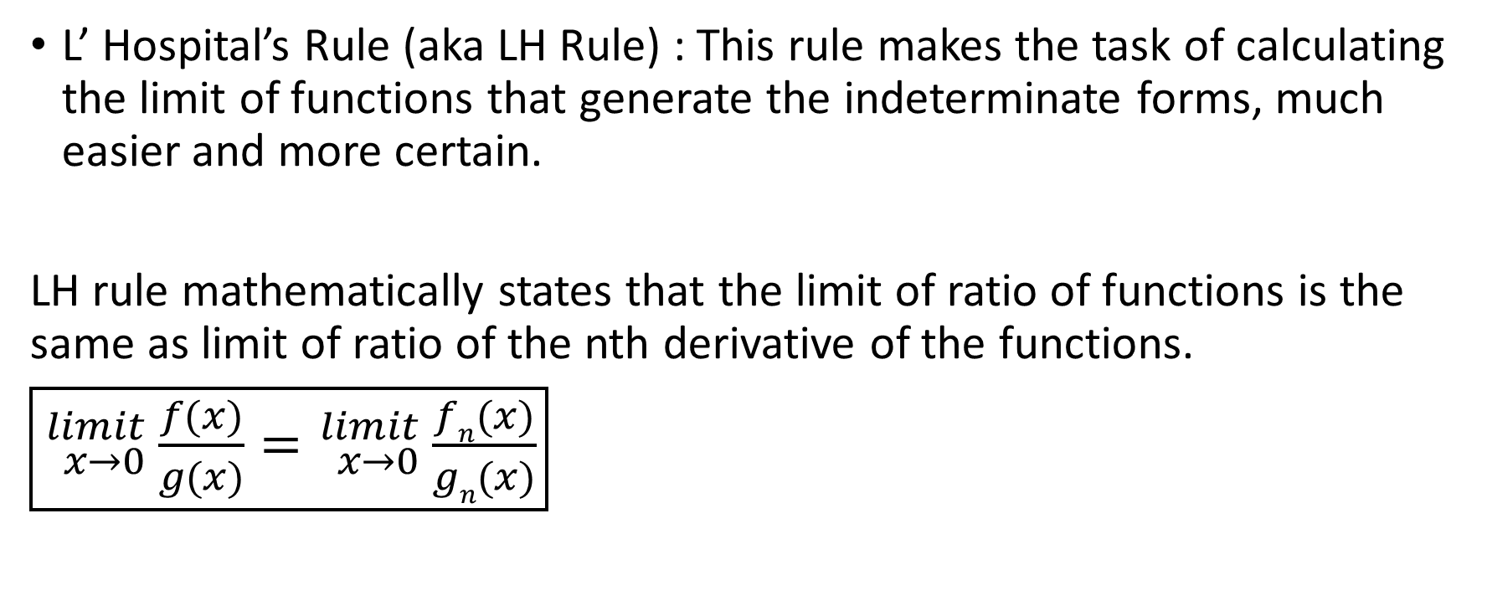
9 L’ Hospital’s Rule
L’ Hospital’s Rule (aka LH Rule) : This rule makes the task of calculating the limit of functions that generate the indeterminate forms, much easier and more certain.
LH rule mathematically states that the limit of ratio of functions is the same as limit of ratio of the nth derivative of the functions.
$\boxed{{}_{x→0}^{limit}{ \frac{f(x)}{g(x)}}={}_{x→0}^{limit}{ \frac{fn(x)}{gn(x)}}}$

Slide 14
Thank you
Shreyas M
B.Tech in ECE PES University Bangalore

